Slide 1
Census Income Study
Data Cleaning and EDA
Andrew Graham – Fall 2022

Slide 2
Contents
Analysis Overview
Data Cleaning
Exploratory Data Analysis

Slide 3
Analysis Overview
Summary and Goals
Data Overview
Meta Data
Train and Test
Input
Output

Slide 4
Analysis Overview
Summary and Goals
The purpose of this data is to create a prediction model to determine the income of an individual based on given census data. The goal of this data has been binned into having a salary of > 50k and < 50k. The data is from the US census bureau.
In this section of the study data cleaning and exploratory data analysis was performed. Analysis and recommendation will be provided to assist the next stage of Data Transformation and Model Creation.

Slide 5
Analysis Overview
Data Overview - Meta
2 Files were provided containing data split into training and testing data
A meta file was provided containing column information, such as: name, description, and types (nominal/continuous)
This file contained a few tables which were combined using a fuzzy matching algorithm and then the resulting information allowed the data to be labeled
The meta document also contained the unique values from the data which was used to assist in data cleaning efforts
Instructions were given in the document to drop a column (Instance Weight), so those instructions were followed.
Data consist of 41features (40 input and 1 output) with 299,285 records

Slide 6
Analysis Overview
Train and Test
Data was split 1/3 into test and 2/3 into train
199,523 training records, 99762 test records
The Kolmogorov-Smirnov distance was used to test the balance of the sets: the closer to 0 the more similar the sets. Each variable rom one section to the next was tested and the max value for each set was taken
Maximum distance before cleaning: 0.004
Maximum distance after cleaning: 0.018
Test and Train splits are balanced and were not significantly affected by the cleaning efforts
The training and test sets were merged for the purposes of Data pre-Processing

Slide 7
Analysis Overview
Data Overview
40 Input features
7 numerical/continuous
33 nominal
The 7 continuous feature did not have missing data although a majority had 0 values
14 nominal features had complete data
19 features were incomplete
14 features were dropped for having over 30% missing data that could not be imputed
6% of the data was dropped for having missing values
Target(Salary) is unbalance with more than 90% in the <50k category

Slide 8
Features Table
name | num_uniq | type | long_name_t1
0 | AAGE | 91 | continuous | age
1 | ACLSWKR | 9 | nominal | class of worker
2 | ADTIND | 52 | nominal | industry code
3 | ADTOCC | 47 | nominal | occupation code
4 | AHGA | 17 | nominal | education
5 | AHRSPAY | 1240 | continuous | wage per hour
6 | AHSCOL | 3 | nominal | enrolled in edu inst last wk
7 | AMARITL | 7 | nominal | marital status
8 | AMJIND | 24 | nominal | major industry code
9 | AMJOCC | 15 | nominal | major occupation code
10 | ARACE | 5 | nominal | mace
11 | AREORGN | 10 | nominal | hispanic Origin
12 | ASEX | 2 | nominal | sex
13 | AUNMEM | 3 | nominal | member of a labor union
14 | AUNTYPE | 6 | nominal | reason for unemployment
15 | AWKSTAT | 8 | nominal | full or part time employment stat
16 | CAPGAIN | 132 | continuous | capital gains
17 | CAPLOSS | 113 | continuous | capital losses
18 | DIVVAL | 1478 | continuous | divdends from stocks
19 | FILESTAT | 6 | nominal | tax filer statu
name | num_uniq | type | long_name_t1
21 | GRINST | 51 | nominal | state of previous residence
22 | HHDFMX | 38 | nominal | detailed household and family stat
23 | HHDREL | 8 | nominal | detailed household summary in household
40 | INST | 0 | ignore | Instance Weight
24 | MIGMTR1 | 10 | nominal | migration code-change in msa
25 | MIGMTR3 | 9 | nominal | migration code-change in reg
26 | MIGMTR4 | 10 | nominal | migration code-move within reg
27 | MIGSAME | 3 | nominal | live in this house 1 year ago
28 | MIGSUN | 4 | nominal | migration prev res in sunbelt
29 | NOEMP | 7 | continuous | num persons worked for employer
30 | PARENT | 5 | nominal | family members under 18
31 | PEFNTVTY | 43 | nominal | country of birth father
32 | PEMNTVTY | 43 | nominal | country of birth mother
33 | PENATVTY | 43 | nominal | country of birth self
34 | PRCITSHP | 5 | nominal | citizenship
35 | SEOTR | 3 | nominal | own business or self employed
36 | VETQVA | 3 | nominal | fill inc questionnaire for veteran's admin
37 | VETYN | 3 | nominal | veterans benefits
38 | WKSWORK | 53 | continuous | weeks worked in year
39 | YEAR | 2 | nominal | NaN
41 | ZA_TARGET | 2 | target | Target +- 50k
42 | ZZ_SPLIT | 2 | reference | Test or Train

Slide 9
Data Cleaning
Data Loading/ Overall
Numerical Features
Nominal Features

Slide 10
Data Cleaning
Data Loading/ Overall
Target feature ZA_TARGET converted to a binary[1,0]
Train and Test data merged with label to differentiate (ZZ_SPLIT)
Feature: Instance Weight dropped as per instructions
67525 duplicate records were removed

Slide 11
Data Cleaning
Numerical Features
All numerical features had data
Values of 9999 were looked at for possible NA, however they seemed to represent a ceiling rather than missing values
Values of 0 were reasonable, however many of them could have been missing data but there was no way to differentiate, so they were left alone
Column types verified to be numerical

Slide 12
Data Cleaning
Nominal Features
Nominal data was converted to lower case and whitespace was trimmed
The following values were found and converted to NA:
'not in universe','?','do not know','na','not in universe under 1 year old’, ‘not in universe or children’
19 features were found to contain NA values
Missing percentages were calculated those over 30% missing were considered for removal
Distribution of those were checked with train and test data and found to be randomly distributed between both
Correlation between NA containing features were checked and none of the removed features correlated with non- removed features
Following the four remaining features had missing values totaling 5.9% of the total data and were balanced between train and test so they were dropped as well.

Slide 13
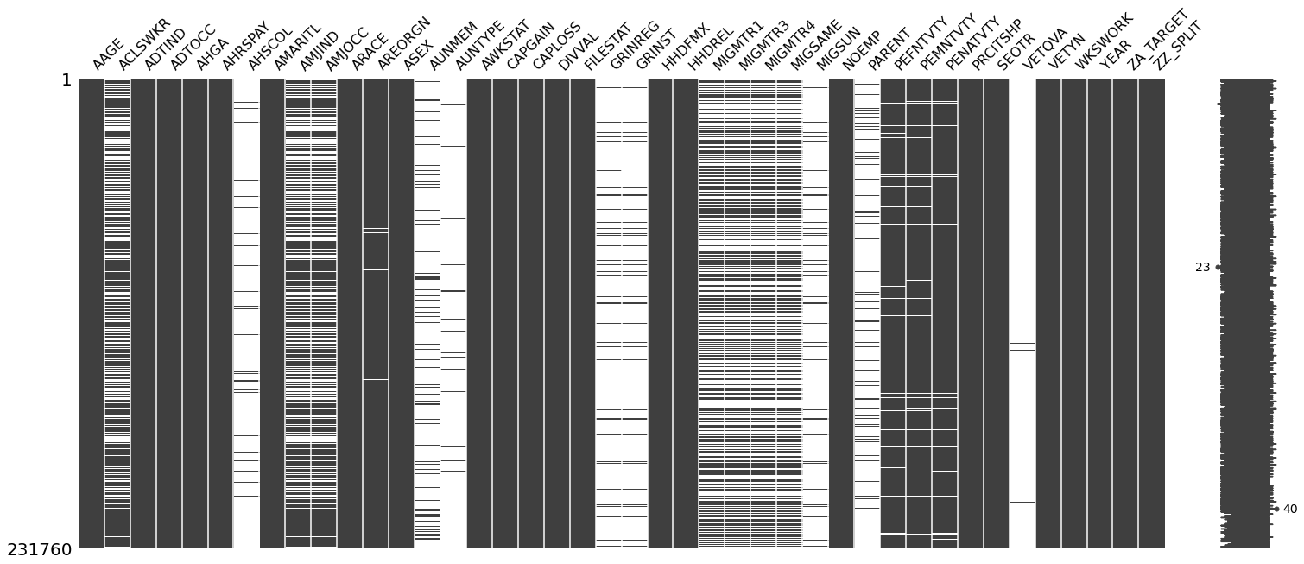
NA Distribution (white is missing)

Slide 14
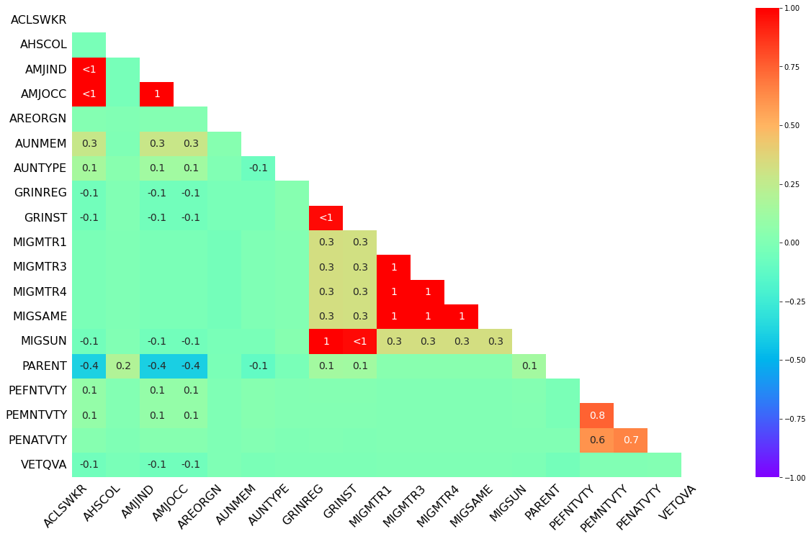
NA Correlation
From this and the prior chartwe see that most columns look to be MCAR/MAR with the following exceptions...
-AMJOCC and AMJIND (Major Industry Code and Major Occupation Code)
This makes sense as they seem to be referencing the same thing
-GRINREG and GRINST (region and state of previous residence)
This makes sense as one is dependent of the other.
-MIGMTR1,MIGMTR3,MIGMTR4 (Migration code Data)
-PEFNTVTY and PEMNTVTY (Birth pace of Parents)

Slide 15
NA Feature Dropping
Since the missingness looks to be random and using a threshold of 30%. The following features should be dropped:
- Feature # Missing Missingness
- AMJIND 84080 0.362789
- ACLSWKR 83508 0.360321
- AMJOCC 84080 0.362789
- MIGSAME 114346 0.493381
- MIGMTR4 114346 0.493381
- MIGMTR3 114346 0.493381
- MIGMTR1 114346 0.493381
- AUNMEM 203225 0.876877
- PARENT 203808 0.879392
- GRINREG 208751 0.900721
- MIGSUN 208751 0.900721
- GRINST 209776 0.905143
- AHSCOL 215546 0.930040
- AUNTYPE 222633 0.960619
- VETQVA 228779 0.987138
With the following to be kept:
- Feature # Missing Missingness
- AREORGN 1672 0.007214
- PENATVTY 5057 0.021820
- PEMNTVTY 8779 0.037880
- PEFNTVTY 9690 0.041810

Slide 16
Exploratory Analysis
Dataset
Target Variable
Numerical Features
Nominal Features

Slide 17
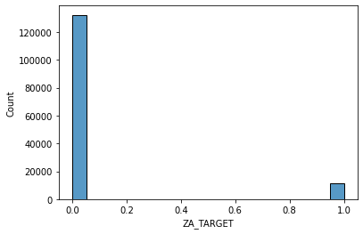
Exploratory Analysis
Target Variable
Target Feature is binned at <50k and >50k
This was converted to 1 for >50 and 0 for <50
Data was clean and had no missing values
The target variable is highly unbalanced, and this will have to be considered for model creation.

Slide 18
Exploratory Analysis
Numerical Features
 | mean | median | min | max | var | std | skew
AAGE | 34.538998 | 33.0 | 0.0 | 90.0 | 4.981140e+02 | 22.318468 | 0.372785
AHRSPAY | 55.105027 | 0.0 | 0.0 | 9999.0 | 7.471515e+04 | 273.340729 | 8.878780
CAPGAIN | 431.742176 | 0.0 | 0.0 | 99999.0 | 2.181608e+07 | 4670.768536 | 19.090569
CAPLOSS | 36.849010 | 0.0 | 0.0 | 4608.0 | 7.278652e+04 | 269.789771 | 7.685924
DIVVAL | 195.851259 | 0.0 | 0.0 | 99999.0 | 3.755251e+06 | 1937.847082 | 27.144287
NOEMP | 1.956172 | 1.0 | 0.0 | 6.0 | 5.592548e+00 | 2.364857 | 0.752317
WKSWORK | 23.178375 | 8.0 | 0.0 | 52.0 | 5.955560e+02 | 24.404016 | 0.210018
7 continuous numerical features.
AHRSPAY (Wage per hour), CAPGAIN, CAPLOSS, and DIVAL are all highly right skewed.
AHRSPAY, CAPGAIN and DIVAL all have ceiling of 9999

Slide 19
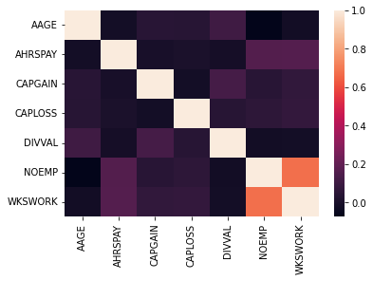
Exploratory Analysis
Numerical Features
Low correlations between most of the variables
NOEMP and WKSWORK have high correlation
This is understandable as someone who has employees likely works a higher amount of weeks

Slide 20
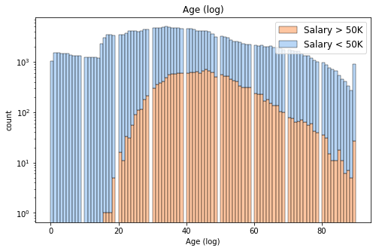
AAGE (Age)
Age column seems reasonable.
90 years looks like a ceiling value.
Under 16 falls in line with not having a salary due to US work laws.
Those with Salary>50k peaks around 35-55.
*Note: counts showed in log scale do to unbalance data to see what values contained >50k

Slide 21
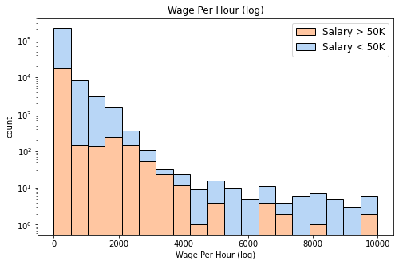
Wage per Hour (AHRSPAY)
Number with No wage: 214874
Percent with No wage: 93%
Minimum wage: 20
Wage per hour seems suspect. Minimum wage is 20, which is very high for the mid 90's. Also 94% of the data has 0 wages, which indicates many this might be missing data.
Data does follow a distribution up to about 5000. Over that the data seems incomplete. Possibly at this level income may or may not come from Salary, but other sources. May want consolidate values over 5000.
*Note: counts showed in log scale do to unbalance data to see what values contained >50k

Slide 22
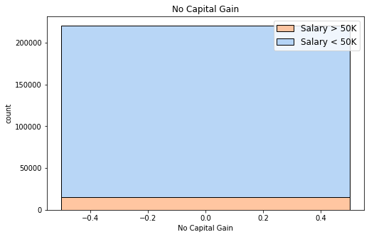
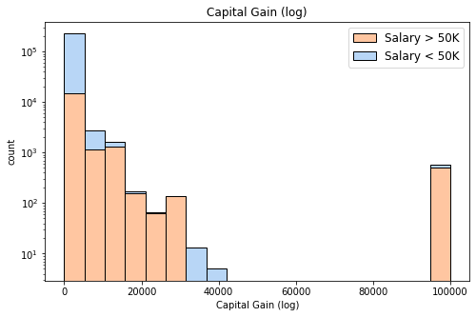
CAPGAIN (Capital Gains)
Number with No Capital Gain: 220666
Percent with No Capital Gain: 95%
Number of Capital Gain: 578
The amount of capital gain doesn't seem to be that correlated with salary, whether there is capital gains seems to have an effect.
Most records show No capital Gain.
Consider switching this to a binary Have/Have no capital Gains.
*Note: counts showed in log scale do to unbalance data to see what values contained >50k

Slide 23
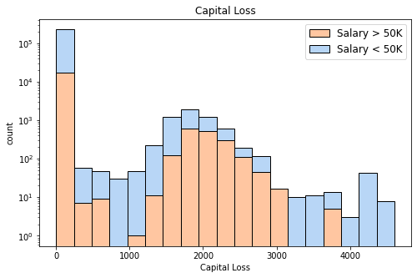
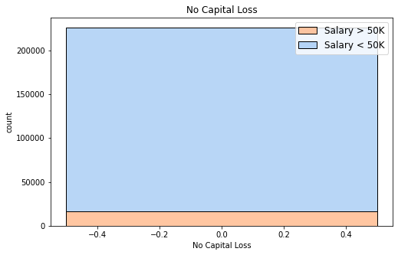
CAPLOSS (Capital Loss)
Number with No Capital Loss: 212684
Percent with No Capital Loss:97%
Number of Capital Loss: 6
The amount of capital gain doesn't seem to be that correlated with salary, whether there is capital loss seems to have an effect.
Most records show No capital Loss.
Consider switching this to a binary Have/Have no capital Loss.
*Note: counts showed in log scale do to unbalance data to see what values contained >50k

Slide 24
DIVVAL (Dividends from Stocks)
Same results as Wage and Capital Gains. Possible Binary candidate.
*Note: counts showed in log scale do to unbalance data to see what values contained >50k

Slide 25
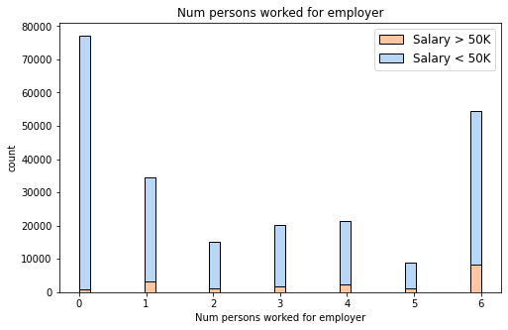
NOEMP (num persons worked for employer)
Very high imbalance, Vast majority with no person working for employer.
*Note: counts showed in log scale do to unbalance data to see what values contained >50k

Slide 26
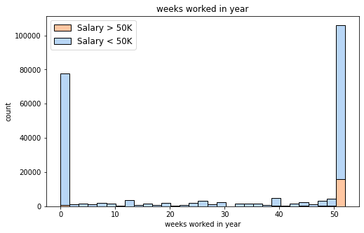
WKSWORK (weeks worked in year)
Majority of values at 0 and 52
Consider binning this into 0, 1-51, 52
*Note: counts showed in log scale do to unbalance data to see what values contained >50k

Slide 27
Exploratory Analysis
Nominal Features Summary
Most features can be left as is
The features with larger number of categories can have them consolidated as many categories only show <50k
Country of organ for mother, father, and self may consider changing to USA not USA if performance looks to be ian issue
Year could possibly be deleted
Education should be updated to Ordinal

Slide 28
Exploratory Analysis
Nominal Features Summary
- ADTIND industry code
Leave as is. Majority are 0
- ADTOCC occupation code
Leave as is. Majority are 0
- AHGA education
Group under 1tth grade, reclassify as Ordinal
- AMARITL marital status
Leave as is.
- ARACE race
Leave as is.
- AREORGN hispanic Origin
Bin into Hispanic/ Not Hispanic
- ASEX sex
Change to binary. Note that Males are overrepresented in salary >50k
- AWKSTAT full or part time employment stat
Consolidate all values relating to unemployed in one category
- FILESTAT tax filer status
Leave as is.
- HHDFMX detailed household and family stat
Consolidate all categories except for householder, spouse of householder, nonfamily householder, secondary individual.
Consider removing for HHDREL
- HHDREL detailed household summary in household
Consolidate all non householder categories
- PEFNTVTY country of birth father
As is, or possible USA and non-USA if performance is an issue
- PEMNTVTY country of birth mother
As is, or possible USA and non-USA if performance is an issue
- PENATVTY country of birth self
As is, or possible USA and non-USA if performance is an issue
- PRCITSHP citizenship
Leave as is
- SEOTR own business or self employed
- VETYN veterans benefits
Leave As is
- YEAR NaN
Consider Removing, seems to be informational to when data was collected

Slide 29
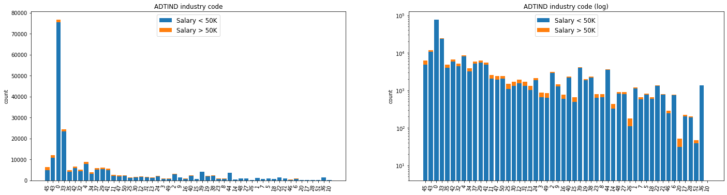
ADTIND industry code

Slide 30
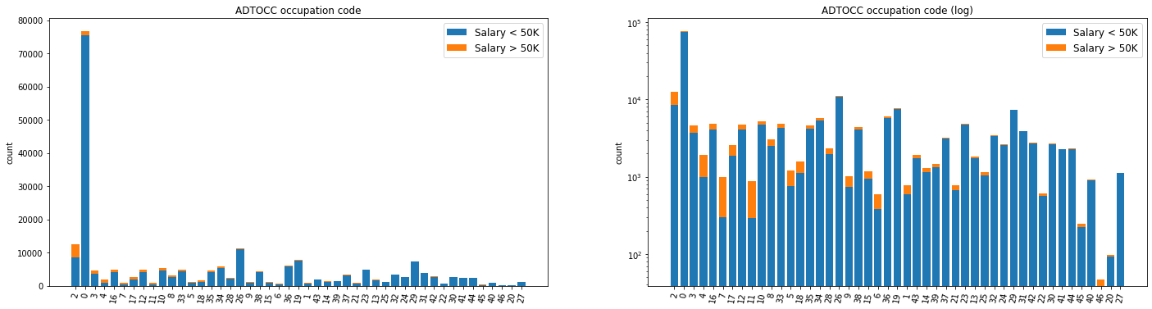
ADTOCC occupation code

Slide 31
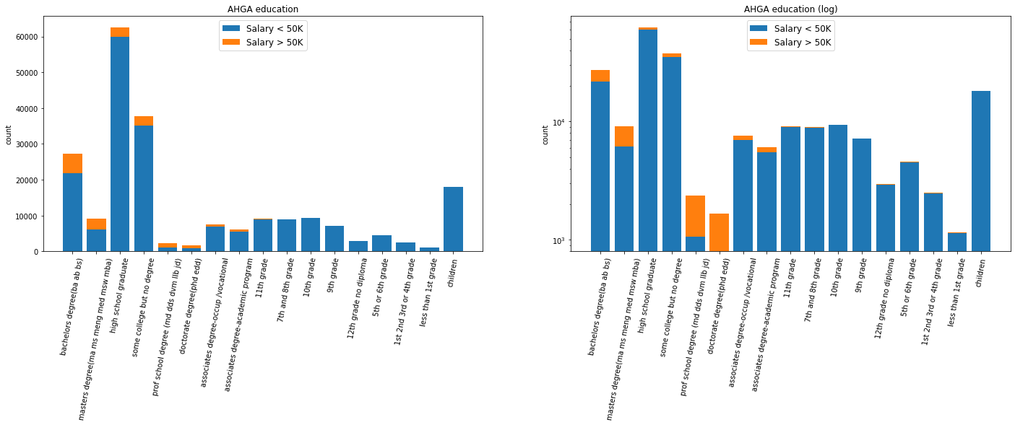
AHGA education

Slide 32
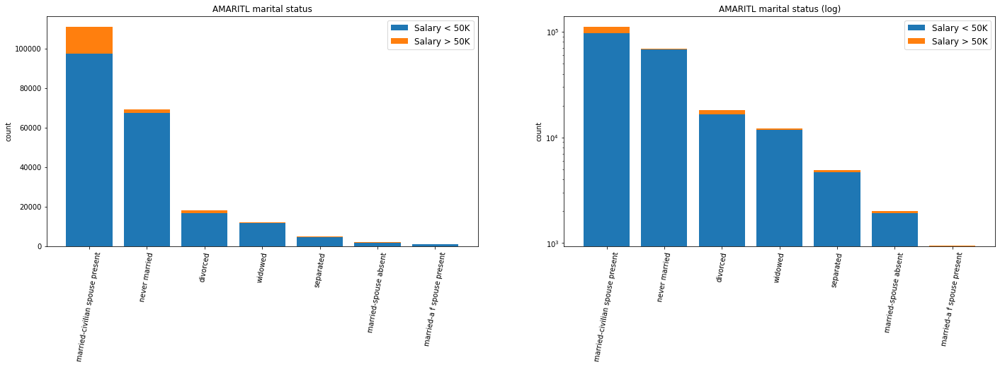
AMARITL marital status

Slide 33
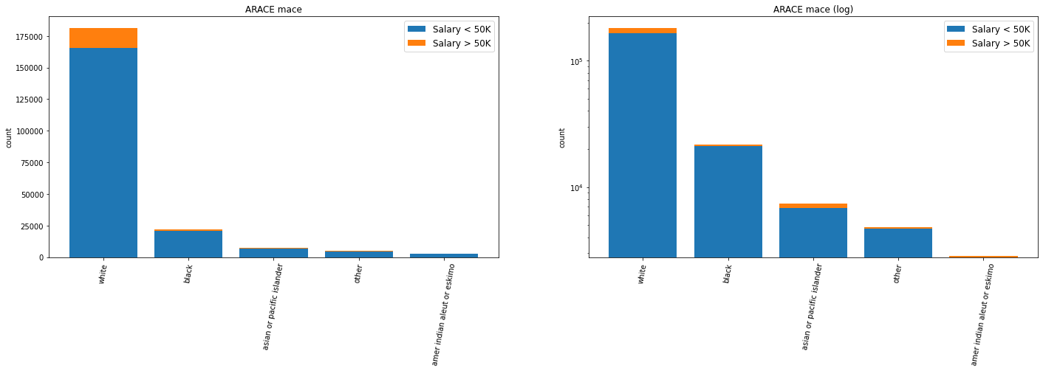
ARACE race

Slide 34
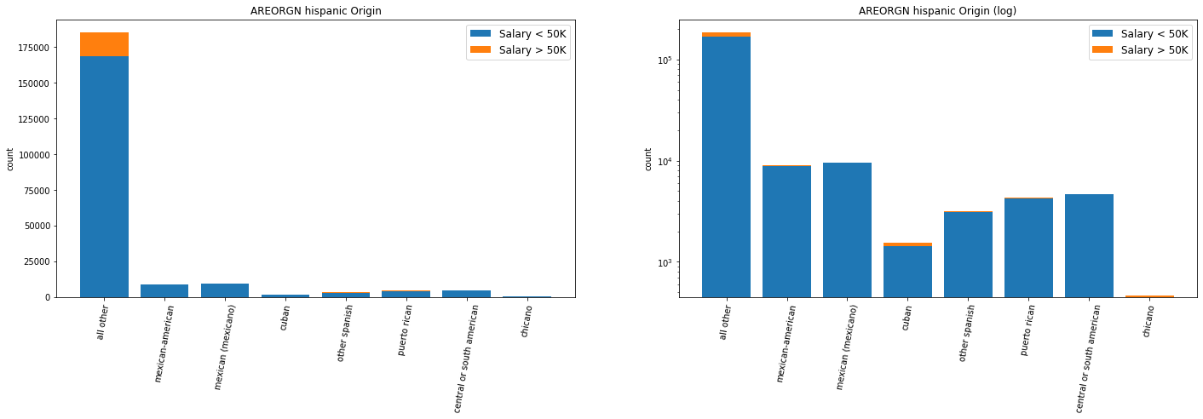
AREORGN Hispanic Origin

Slide 35
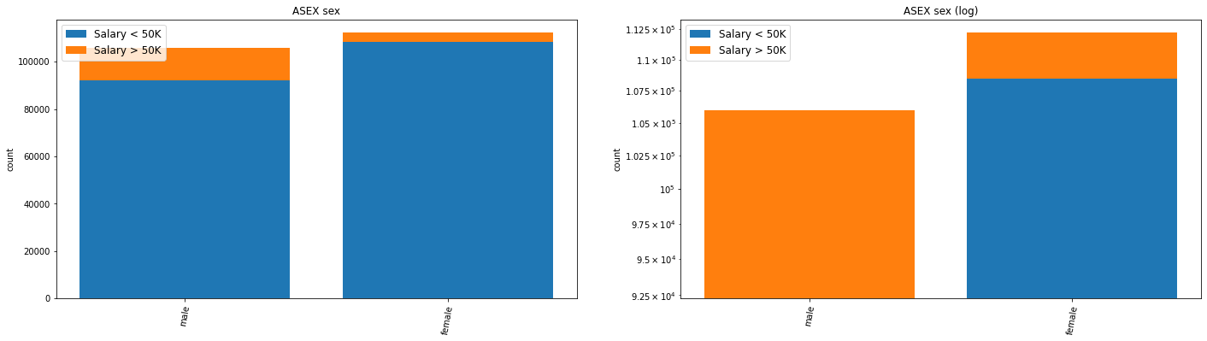
ASEX sex

Slide 36
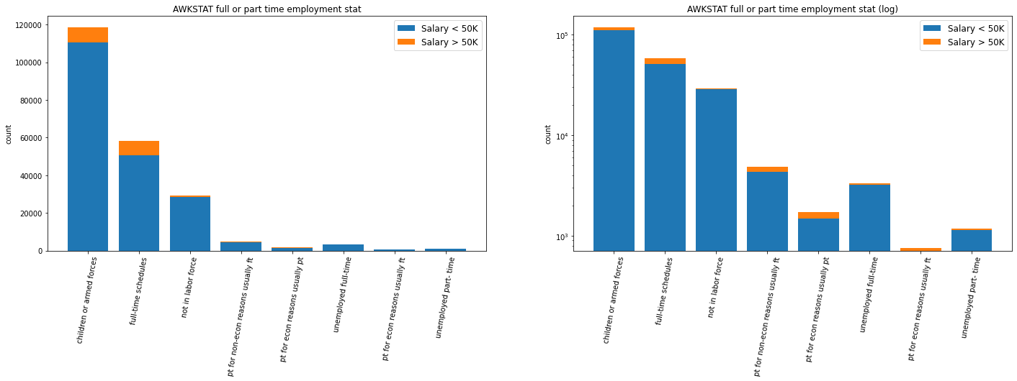
AWKSTAT full or part time employment stat

Slide 37
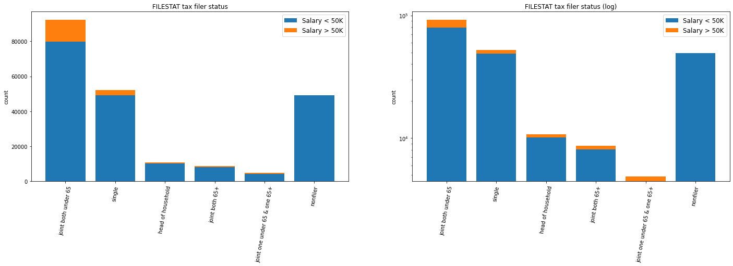
FILESTAT tax filer status

Slide 38
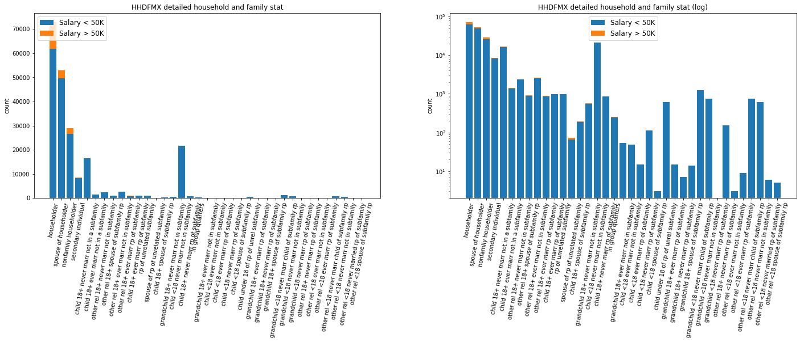
HHDFMX detailed household and family stat

Slide 39
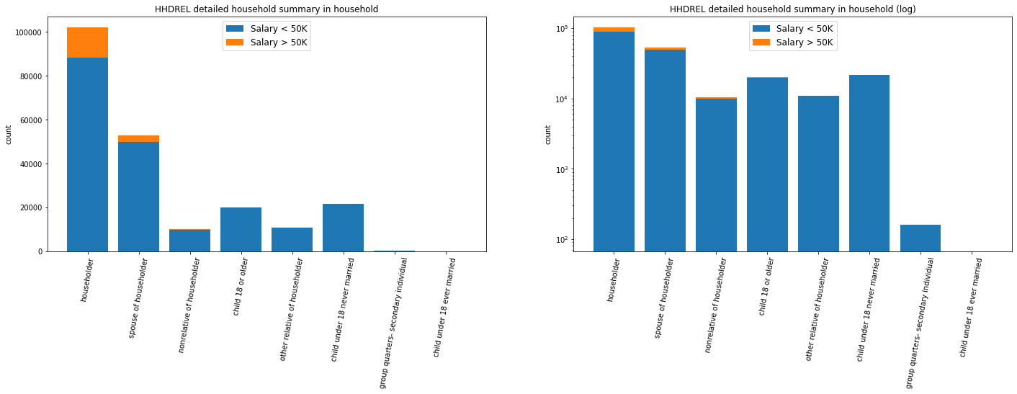
HHDREL detailed household summary in household

Slide 40
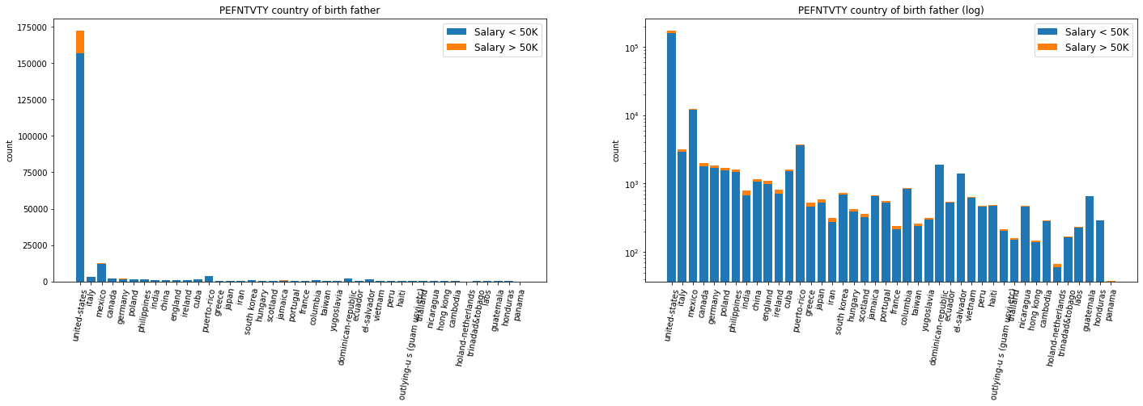
PEFNTVTY country of birth father

Slide 41
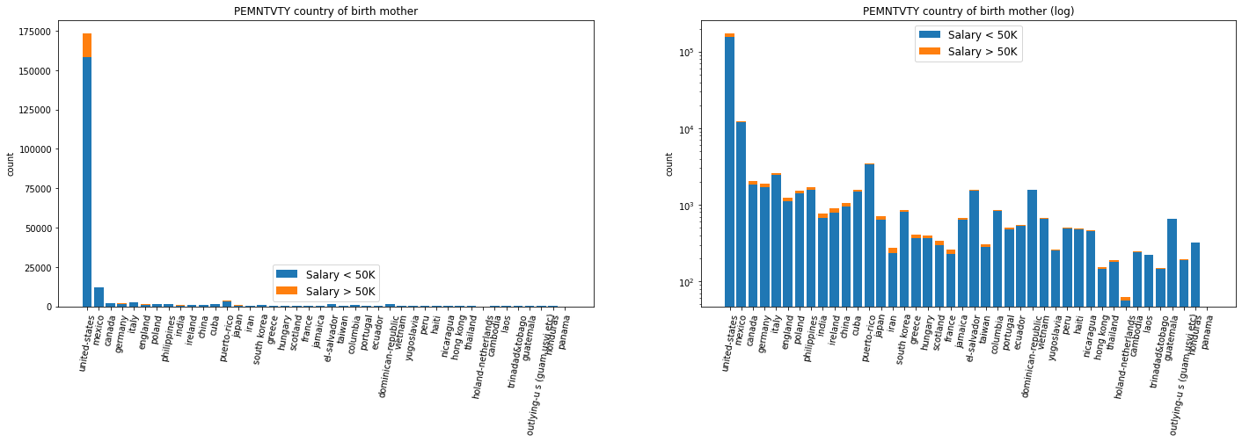
PEMNTVTY country of birth mother

Slide 42
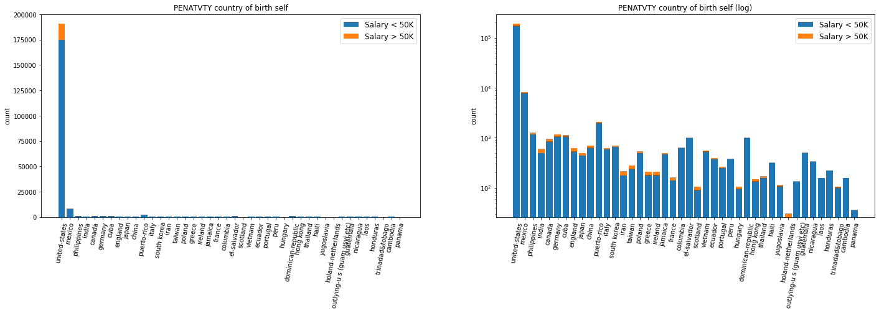
PENATVTY country of birth self

Slide 43
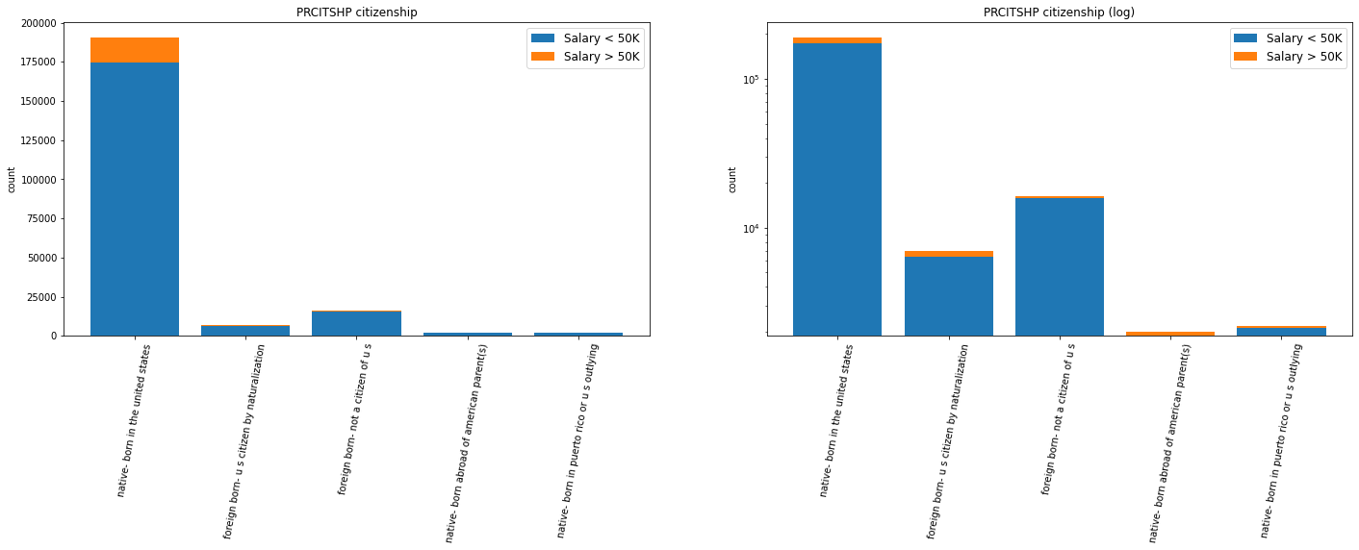
PRCITSHP citizenship

Slide 44
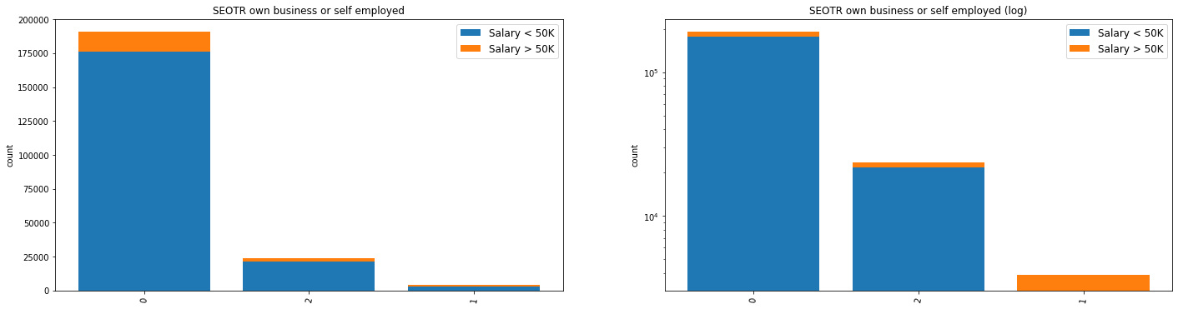
SEOTR own business or self employed

Slide 45
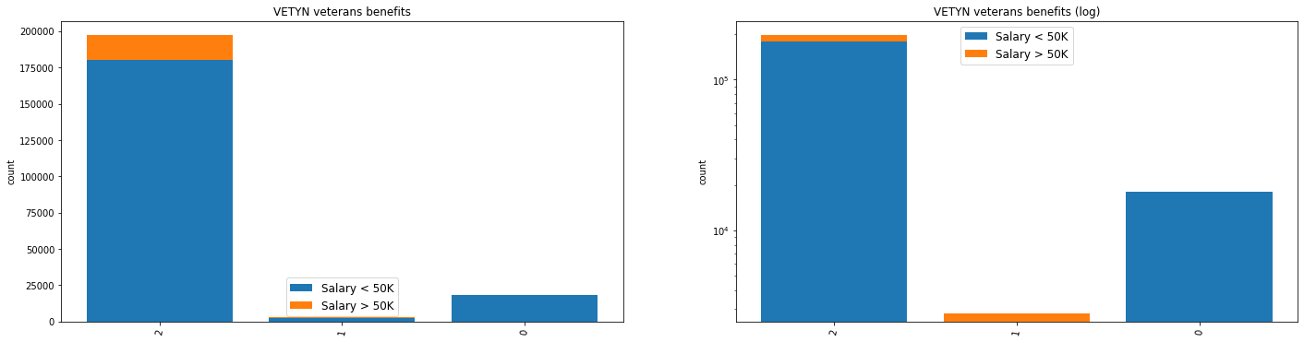
VETYN Veteran’s benefits

Slide 46
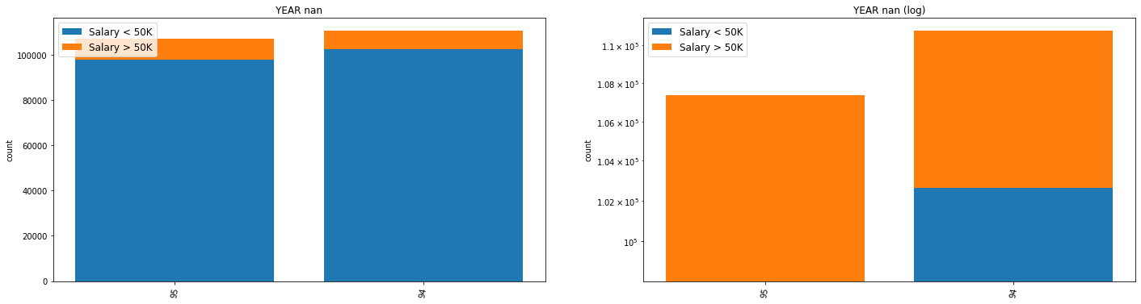
YEAR

